Slide 1

Big-Data & Analytics Definition, use cases and challenges
Juan Carlos Martinez Ovando

Slide 2
B
IG DATA
Agenda
Concepts
Analytics
Use cases
Water sector

Slide 3
What is “big data”?
10101000101010001011010110110110100010101110001010100010100010111010110001001101001101001000010101001111011101101101101010100001110010101100101010011101010001010100010110101101101101001
"Big Data are high-volume, high-velocity, and/or high-variety information assets that require new forms of processing to enable enhanced decision making, insight discovery and process optimization” (Gartner 2012)
Complicated (intelligent) analysis of data may make a small data “appear” to be “big”.
Bottom line: Any data that exceeds our current capability of processing can be regarded as “big” (as many other things in life, “big” is relative and subjective).

Slide 4
Government
Obama administration announced “big data” initiative
Many different big data programs launched
Private sector
Walmart handles more than 1 million customer transactions every hour, which is imported into databases estimated to contain more than 2.5 petabytes of data
Facebook handles 40 billion photos from its user base.
Credit Card Fraud Detection System protects 2.1 billion active accounts world-wide
Why is “big data” a “big deal”?
Science
Terabyte of data every 5 days.
Biomedical computation like decoding human Genome & personalized medicine
Social science revolution…

Slide 5
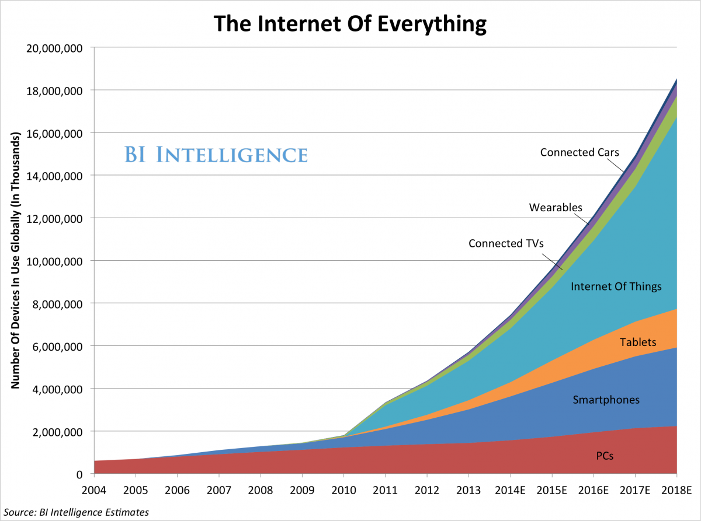
Where is this Big Data coming from? It’s from the Mobile Planet and Internet of Everything…
We’re About Here

Slide 6

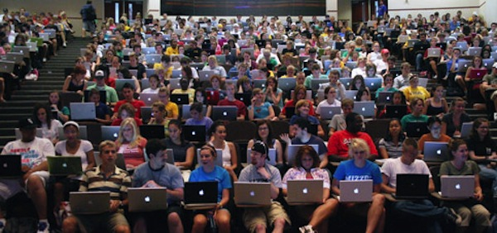
Where is this Big Data coming from? It’s User-Generated Content…
(source: courtesy of Brian Hilton)

Slide 7
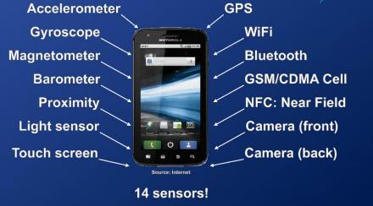


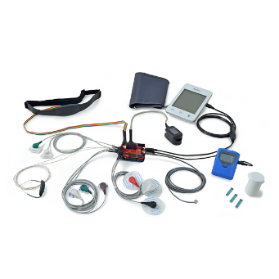
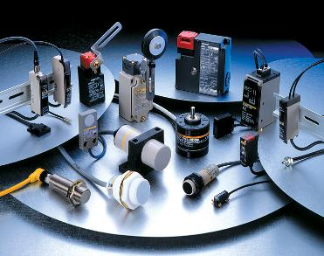
Where is this Big Data coming from? It’s Sensor Data…
(source: courtesy of Brian Hilton)

Slide 8
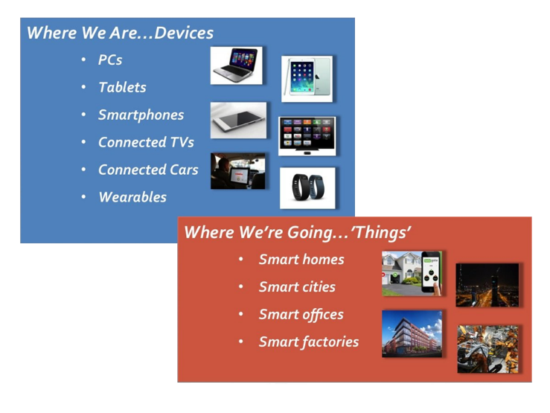

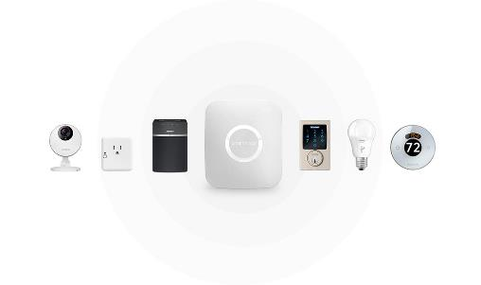
Where is this Big Data coming from? It’s all these “Smart” “Things”…
(source: courtesy of Brian Hilton)
Notes:
http://www.smartthings.com/

Slide 9
Five V’s of Big Data --Sometimes referred as the four V’s--
V1 = Volume
Satellite imagery covers the globe so is vast.
Sensors are expanding worldwide at a rapid rate.
Digital cameras have reached several billion through spatially-reference cell phones.
One estimate indicates that 2.5 quintillion bytes are generated daily worldwide. (www.ibm.com). 2.5 with 18 zeros.
V2 = Variety
The form of data is based on 2-D or 3-D points configured as vector or raster imagery. This is entirely different than conventional big data which is alphanumeric or pixel-based (similar to raster but not vector)
V3 = Velocity
Velocity is very fast since imagery travels at speed of light.

Slide 10
Five V’s of Big Data (cont.) --Sometimes referred as four V’s--
V4 = Veracity
Attribute veracity
For attribute data, do the data meet data quality tests?
Cross checking totals against other sources or historical trends
Examination of outliers
Review and audit of data collection techniques
Special veracity
For vector data (imagery based on points, lines, and polygons), the quality varies. It depends on whether the points have been GPS determined, or determined by unknown origins or manually. Also, resolution and projection issues can alter veracity.
For geocoded points, there may be errors in the address tables and in the point location algorithms associated with addresses
For raster data (imagery based on pixels), veracity depends on accuracy of recording instruments in satellites or aerial devices, and on timeliness.

Slide 11
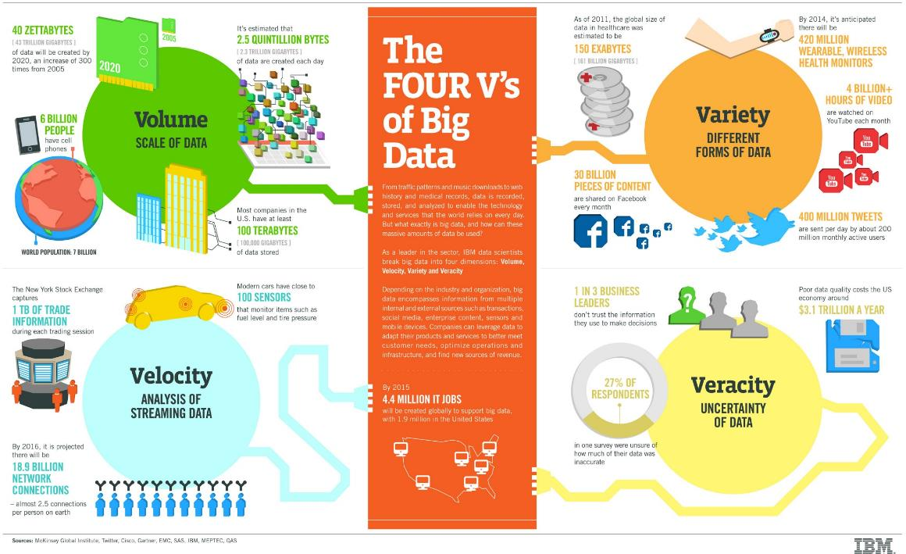

Slide 12
Five V’s of Big Data (cont.) --And, the “new” V--
V5 = Value
For real-time big data, decisions can be enhance through visualization of dynamic change in such spatial phenomena as climate, traffic, social-media-based attitudes, and massive inventory locations.
Exploration of data trends can include proximities and relationships.
Once big data are structured, formal analytics can be applied, such as autocorrelation, overlays, buffering, spatial cluster techniques, and location quotients.

Slide 13
B
IG DATA
Agenda
Concepts
Analytics
Use cases
Water sector

Slide 14
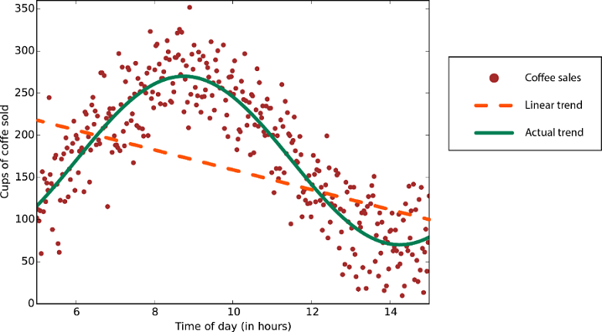
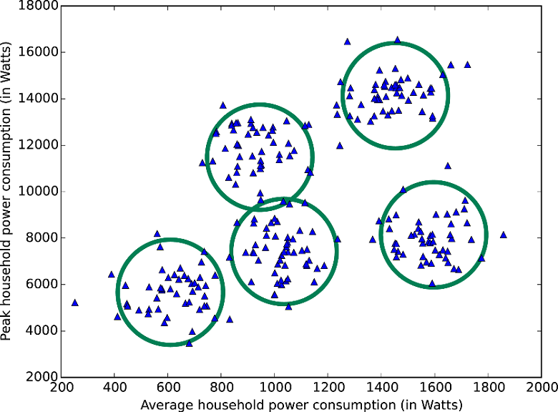
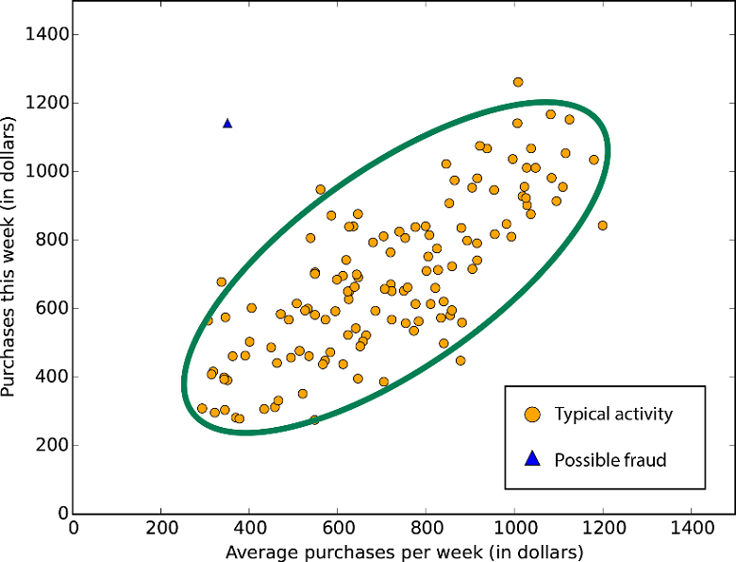
Big Data Analytics “Traditional” Techniques
What is enabling them?
Classification
Clustering
Regression
Simulation
Anomaly Detection
Numerical Forecasting
Optimization
Geographic Mapping
…
Limitations. For Big Data, they often cannot handle well the first 3 V’s of volume, velocity, and variety They tend to work best with “Small Data”
Notes:
Predictive Analytics with Microsoft Azure Machine Learning 2nd Edition

Slide 15
Example of Analysis: Clustering (LFA)
Group M1
Group M2
 | Movie 1 | Movie 2 | … | Movie m
User1 | 3.5 | 4 |  | 5
User2 | 5 | 1
…
User n | 2 | 1 |  | 4
Group U1
Group U2

Slide 16
Example of Analysis: Predictive Modeling
Group M1
Group M2
 | Movie 1 | Movie 2 | … | Movie m
User1 | 3.5 | 4 |  | 5
User2 | 5 | 1
…
User n | 2 | 1 |  | 4
Group U1
=?
Group U2
Does user2 like movie m?
(Binary) Classification
What rating is user2 likely going to give movie m?
Regression

Slide 17
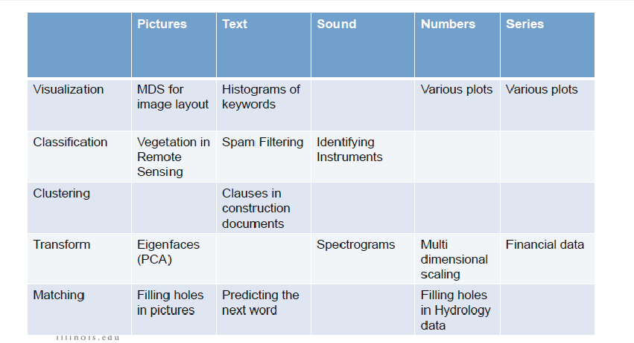
Other examples

Slide 18
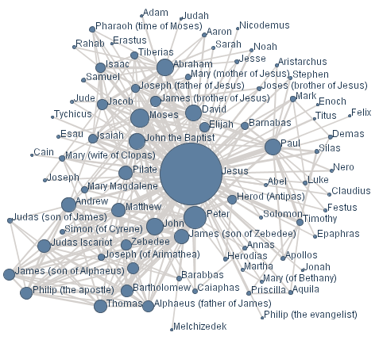
Networks and Graphs Individual entities
Visualizing networks is helpful, even if is not obvious that a network exists.

Slide 19
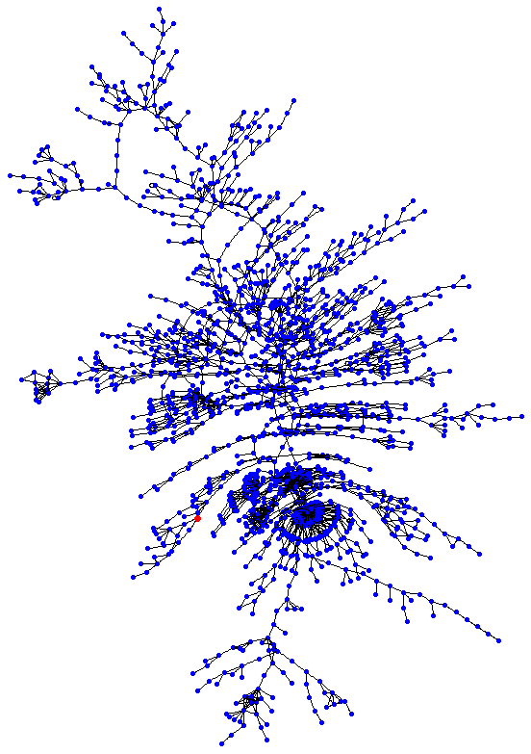
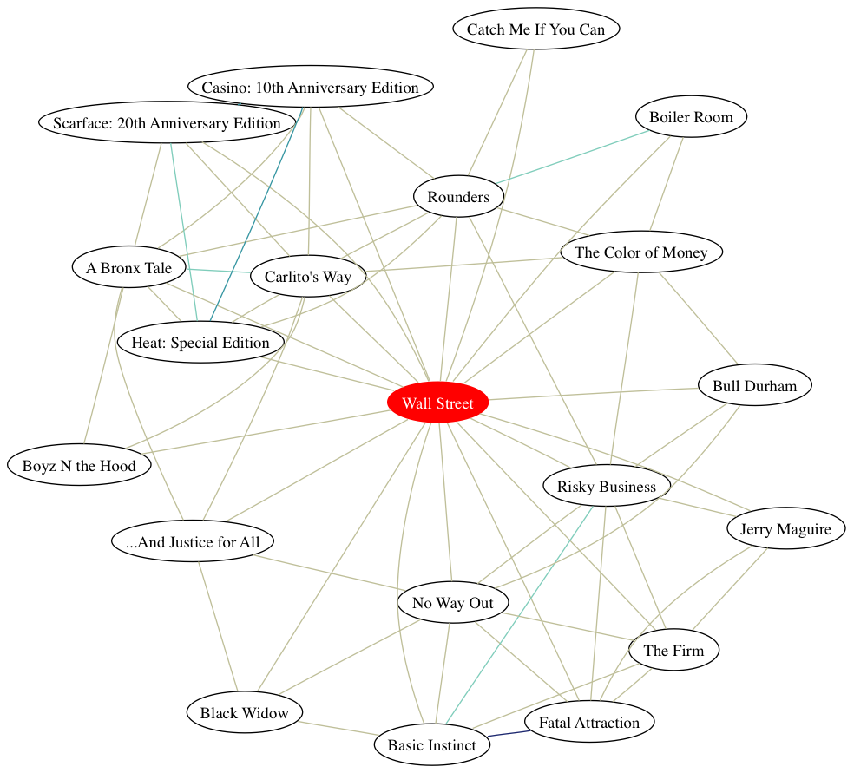
Networks and Graphs Atributes

Slide 20


Implementation
Performance
...
Fault tolerance
...
Cost
...
Easy of use
...
Data procesing
...
Security
...

Slide 21
B
IG DATA
Agenda
Concepts
Analytics
Use cases
Water sector

Slide 22

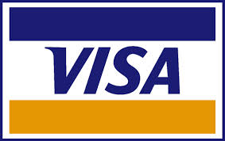















A Single View to the Customer
Social Media
Banking
Finance
Gaming
Our
Known
History
Customer
Entertain
Purchase

Slide 23
Real-Time Analytics / Decision Requirement
Influence
Behavior
Product
Recommendations
that are Relevant
& Compelling
Learning why Customers
Switch to competitors
and their offers; in
time to Counter
Customer
Improving the
Marketing
Effectiveness of a
Promotion while it
is still in Play
Friend Invitations
to join a
Game or Activity
that expands
business
Preventing Fraud
as it is Occurring
& preventing more
proactively

Slide 24
Target customers
Better understand and target customers
To better understand and target customers,
companies expand their traditional data sets with
social media data, browser, text analytics or
sensor data to get a
more complete picture of their customers.
The big objective, in many cases, is to create
predictive models.
Impact
Using big data, companies can now better predict customer churn; retailers can predict what products will sell, when and to whom, and car
insurance companies understand how well their customers actually drive.

Slide 25
Understand and Optimize Business Processes
Retailers are able to optimize their stock based on predictive models generated from social media data, web search trends, weather forecasts and macroeconomic environment.
Another example is supply chain or delivery route optimization using data from geographic
positioning and radio frequency identification sensors.

Slide 26
Improving Health
The computing power of big data analytics enables us to find
new cures and better understand and predict disease
patterns. We can use all the
data from smart watches and
wearable devices to better
understand links between
lifestyles and diseases.
Big data analytics also allow us to monitor and predict epidemics and disease outbreaks, simply by listening to what people are
saying, i.e. “Feeling rubbish today - in bed with a cold” or searching for on the Internet.
Health

Slide 27
B
IG DATA
Agenda
Concepts
Analytics
Use cases
Water sector

Slide 28
Water consumption
Global risks
The International Energy
Agency projects water
consumption will
increase by 85% by 2035
to meet the
needs of energy generation
and production.
Risks
Global water
requirements are
projected to be pushed
beyond sustainable
water supplies by
40%
by 2030.
Water
consumption x6
Trends
World’s
population x3

Slide 29
Integrated Water Network Management
GIS
What it is?
Asset Mangnt
ERP
Water loss
“A fully integrated set of data-driven components and solutions, which allow water utilities to optimise all aspects of their water distribution system”
Work order mangnt
Control room
The goal
A leak is born
A smart water solution detects, measures and locates it
A job is automatically raised, prioritised and scheduled
Automated street works approval!
The repair team arrives with correct schematic and equipment
The leak is repaired
Smart technology confirms that everything is back to normal
Customer service
Billing
Water quality
Lots of data sources in silos = Chaos

Slide 30
Big-data prediction algorithms
01
Prediction
Learn network behaviour patterns
Behaviour
02
Predict customer future behaviour
03
Anomalies
Statistically compare readings to predicted behavior to detect anomalies
History prediction
04
Historic prediction historical data for same area
05
Network prediction
Network prediction current behaviour across the
network

Slide 31
B
IG DATA
Agenda
Summary

Slide 32
Summary on Big Data and Analytics
Big Data refers to huge data-sets that overflow ordinary data management systems.
The 5 V’s define big data including Volume, Variety, Velocity, Veracity, and Value.
Ordinary, small-data approaches will not work, because most of the traditional techniques cannot perform exploration of massive data sets.
Big Data methods allow multidimensional screening and “data mining” to locate parts of the mass that are showing interesting relationships, trends, or comparisons.
Those interesting parts of a Big Data Set can be sorted into small data-sets that can have the more powerful traditional analysis methods applied to them.
The management issues of Big Data are not yet figured out.
Success need to be studied from a management and organizational standpoint to understand what works managerially and results in profits and other benefits.
…………………………………..

Slide 33
B
IG DATA
Agenda
References

Slide 34
References
Bernard Marr
Big Data in Practice
https://onlinelibrary.wiley.com/doi/book/10.1002/9781119278825
Dawn E. Holmes
Big-Data
https://www.amazon.com/Big-Data-Short-Introduction-Introductions/dp/0198779577
…………………………………..

Slide 35
Thank you for your attention!
Grupo Rotoplas - Big-Data

